Slide 1

CPS based Smart Waste Management System IoT - LoRA
M.Tech (Online) Programme Name: IoT & Autonomous Systems
College / University Name : IIIT Sri City, Chittoor
Guide Name: Prof.HRISHIKESH VENKATARAMAN
Smart Waste Management System Waste Collection & Route Optimization
Project By
Danush Guntupalli [OMIO25S00020]
Saba Afreen Khatoon [OMIO25S00045]
Nagaraju Marella [OMIO25S00030]

Slide 2
Introduction to project & importance
Problem Statement
Traditional methods of waste collection
Rapid urban growth increases waste generation
Traditional collection is inefficient & costly
Overflowing bins affect hygiene
IoT enables real-time monitoring
Supports Smart and Clean cities
Overflowing bins → Pollution & Diseases
No real-time data for collection
Fuel & time wasted in manual monitoring
Need a cost-effective & scalable solution

Slide 3
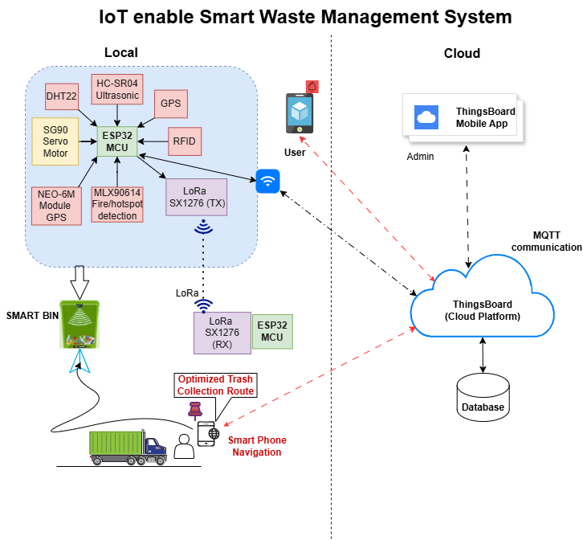
Implementation
List of Hardware Components
System Architecture
MCU :ESP32 (Qty. 2 Nos.)
Sensors:
Ultrasonic (HC-SR04)
Temp/Humidity (DHT22)
GPS Module(NEO-6M)
Fire/Hotspot Detection(MLX90614)
RFID
LoRA (SX1276) Tx & Rx
Servo Motor (SG90)
Proximity Sensor

Slide 4
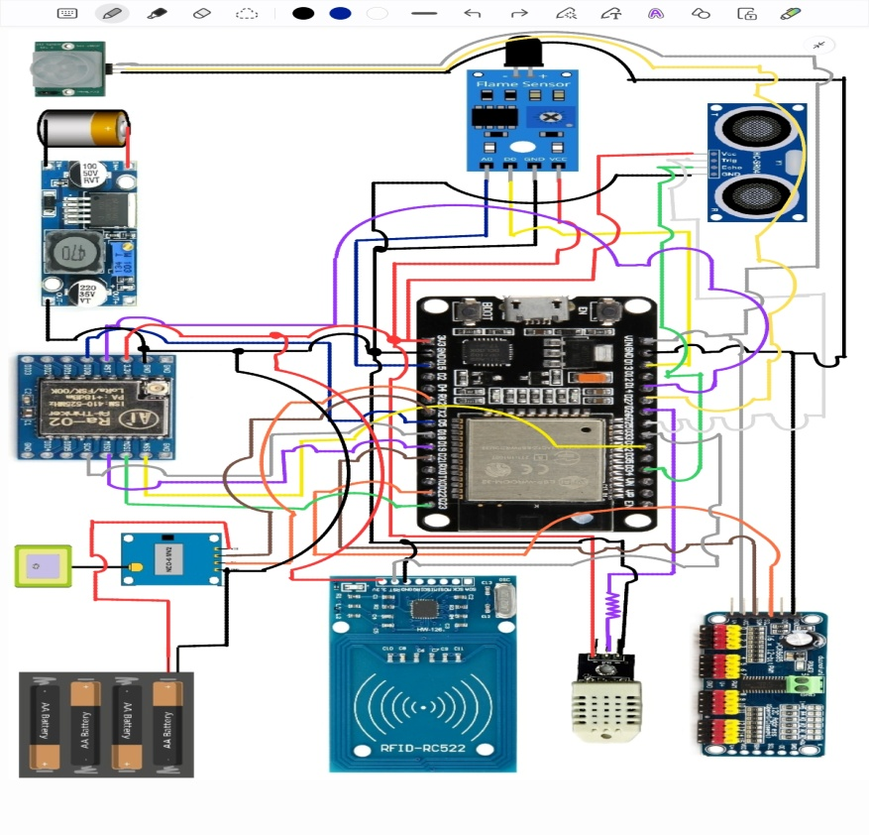
Smart Bin (ESP32+Sensors + LoRA Tx)
Wiring Diagrams -1

Slide 5
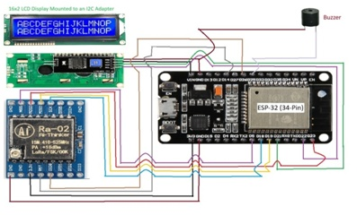
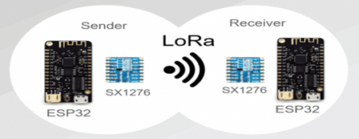
Remote Data Collection(ESP32+LoRA Rx)
Wiring Diagrams-2

Slide 6
Deliverables
LoRa Point-to-Point Communication
Works up to 1–5 km in urban
Ultra-low power usage
Works without Wi-Fi
Best for outdoor IoT Smart bins
System Workflow
Bin senses fill level
ESP32 collects & processes data
LoRa Point –to- Point Communication
Cloud updates live status
Alerts when threshold is reached
Optimized vehicle routing
Deliverables | Output
CPS Project Deliverables | ESP32 + sensors + LoRa
Deliverable 1 : Bin Level Deliverable 2 : Optimized Route Map | 1. Bin Level visualization 2. ML Algorithm(Simulated): Generates Optimized Route Map (using GPS Dataset) send to vehicle driver

Slide 7
Tools Used in the Project
1. Arduino IDE
Used for coding ESP32 firmware
Upload IoT Cloud Platform sensor + LoRa
communication code
Serial monitoring & debugging
3. LoRa Config Tools
LoRa library in Arduino
Used to:
Configure LoRa modulation settings
Test point-to-point communication
4. Circuit schematic + breadboard diagrams
2. IoT Cloud Platform
Platform | Purpose
ThingsBoard | Data visualization + real-time bin monitoring graphs
 | Mobile app notifications + live status
 | Custom UI, alerts & flow-based control
5. Data Analytics
Python for data logging & route analytics
Used to:
Analyse fill-level history
Optimize truck route planning
6. Documentation Tools
PowerPoint – Presentation slides

Slide 8
Challenges faced
The LoRa module’s high transmission current, coupled with high current consumption of NEO-6M for cold starting occasionally caused voltage dips resulting in random shutdown of ESP-32. Additional external power supply is used for improved stability.
Integrating both the RC522 RFID module and the LoRa Ra-02 on a shared SPI bus resulted in intermittent communication failures. Careful management of chip-select signals and SPI transaction timing was required to ensure stable operation.
Simultaneous handling of Wi-Fi, LoRa, GPS, and sensor polling introduced timing conflicts. The use of FreeRTOS queues and non-blocking loops was necessary to prevent watchdog resets.
The 255-byte payload restriction in the SX1278 chipset mandated the design of a cyclic packet transmission sequence. Splitting sensor data into multiple sub-packets increased firmware complexity.
Maintaining consistent user ENTRY/EXIT states required timeout mechanisms and robust handling of rapid tag taps.

Slide 9
Future Scope (If Given a Chance)
AI-based waste prediction
to estimate when bins will get full and schedule trucks proactively
Automated waste segregation
using image sensors / AI for separating recyclable & non-recyclable waste
Solar-powered smart bins
for longer outdoor operation without manual battery maintenance
GPS-enabled bins & vehicles
to track location and improve route planning
Integration with Smart City e-Governance apps
for citizen reporting and transparent monitoring
Public awareness notifications
on hygiene, bin locations, and recycling through a mobile app
Edge computing at gateway
to reduce cloud dependency and improve response time
Expansion to hazardous waste monitoring
like medical or chemical disposal areas

Slide 10
Conclusions
Implementing IoT-based smart waste management enhances
Urban hygiene and Operational Efficiency.
Real-time Monitoring reduces
Fuel consumption, Manpower, and environmental impact, supporting scalable
solutions aligned with smart city missions.
Continuous innovation and integration of advanced technologies will drive
sustainable urban waste solutions for the future.

Slide 11
Thank you

